Slide 1
First Term Success Workshop
Sailor and Family Support
Notes:
FACILITATOR GUIDE:
The Navy’s job is to ensure Sailors are cared for, but your families are apart of the Navy concern also. These resources will give you guidance and assistance if you are ever in need.

Slide 2
Enabling Objectives
IDENTIFY U.S. Navy programs that support you as the Sailor and your families.
IDENTIFY Benefits and resources offered to Sailors and their families.
Notes:
FACILITATOR GUIDE:
Review objectives

Slide 3
References
OPNAVINST 1750.1 (series)- Navy Family Ombudsman Program
Fleet and Family Support- https://www.mynavyhr.navy.mil/Support-Services/Culture-Resilience/Family-Readiness/Fleet-Family-Support/
Military OneSource- https://www.militaryonesource.mil/
Navy and Marine Corps Relief Society-https://www.nmcrs.org/
Notes:
FACILITATOR GUIDE:
Review references

Slide 4
OMBUDSMAN
Ombudsman are Navy Spouse volunteers, appointed by the Commanding Officer and serve two important roles:
  Serve as the communication link between the Commanding Officer and families of Sailors within the command.
  Serve as a trained referral source for regarding command information and sources available the command’s families.
Notes:
FACILITATOR GUIDE:
Mention who the Command OMBUDSMAN is and elaborate on the assistance they provide to the Sailors and families at your command.
If your OMBUDSMAN assists with the Fleet Readiness Group you can mention that as well.

Slide 5
Fleet and Family Support Centers
“The primary mission of the Fleet and Family Support Program (FFSP) is to support Navy leadership in achieving maximum mission readiness.”
Commands, Sailors and their family members have access to a wide range of programs, focused on adaptation to the special demands of military careers and military family life.
Notes:
FACILITATOR GUIDE:
None

Slide 6
Fleet and Family Support Centers
Fleet and Family Support
  Family Advocacy Program (FAP)
  Sexual Assault Prevention and Response (SAPR)
  Personal Financial Management Program
  Relocation Assistance
  Deployment Support
  Spouse Education and Career Opportunities (SECO)
  Non-Medical Individual and Family Counseling
  New Parent Support
Command Personal and Family Readiness
  Command Sponsor and Indoctrination
  Personal and Family Readiness (PFR) Support for IAs and their Families
  Family Care Plan (FCP)
  Family Readiness Groups (FRGs)
Personal and Family Readiness Support
  Transitional Compensation for Abused Dependents (TCAD) Program
Wellness and Prevention
  Deployment Health Assessment (DHA)
Retired Activities
  Retired Activities
  SECNAV Retiree Council
Notes:
FACILITATOR GUIDE:
You do not need to brief every thing on this slide. Hit certain aspects and provide overview of the programs FFSC provides.

Slide 7

Fleet and Family Support Centers cont…
Notes:
FACILITATOR GUIDE:
This slide shows what a Fleet and Family Support Center offers on their website as an example. If you have connectivity go to the FFSC webpage for your AOR and show your Sailors. If not, use this as an example of what the FFSC website may look like as well as explain what services are offered. You can also use this time to discuss MWR options and the programs that are available. If you’re in an AOR that does not have a major FFSC, explain what your FFSC team offers.
**Remember each FFSC is not the same and may offer different services based on area needs. Ensure to research this information prior to briefing this slide.

Slide 8
Military OneSource
From the Department of Defense is your 24/7 gateway to trusted information, resources and confidential help. When life happens, it’s your “first line of support” — giving service members and military families tools to stay well and thrive.
This website includes resources for PCS, Personal Property Moves, Self-care, Stress & Mental Health Support, etc.
Notes:
FACILITATOR GUIDE:
Overview of Military OneSource.

Slide 9
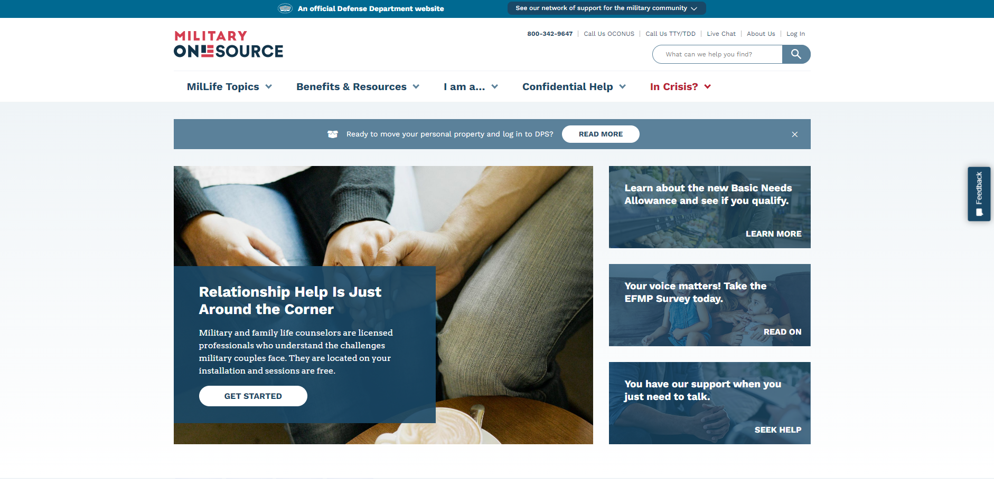
Military OneSource cont…
Notes:
FACILITATOR GUIDE:
This is the homepage of the Military OneSource website, you can use this to show Sailors what they will see when they go to the page.

Slide 10
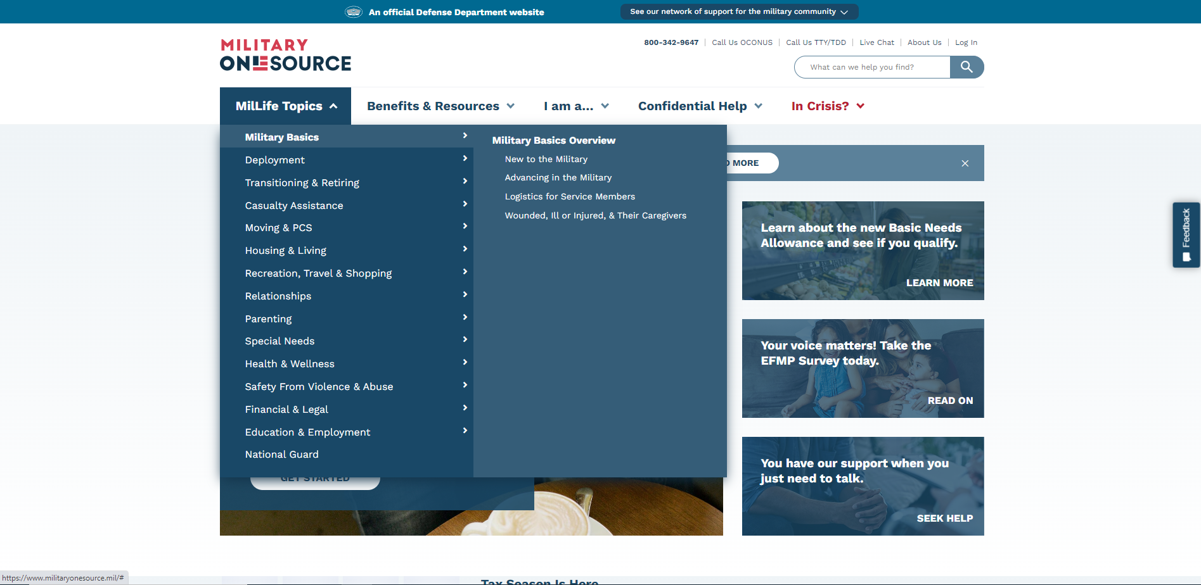
Military OneSource cont…
Notes:
FACILITATOR GUIDE:
When briefing this slide hit the major points of what is offered by Military OneSource. Example: mention the services of deployment, moving and PCS, housing and living.
You can brief to the crowd of Sailors you have and what is important to them. Also, think about what is going to impact them the most as First Term Sailors and what will be beneficial for them while providing an overview of Military OneSource.

Slide 11
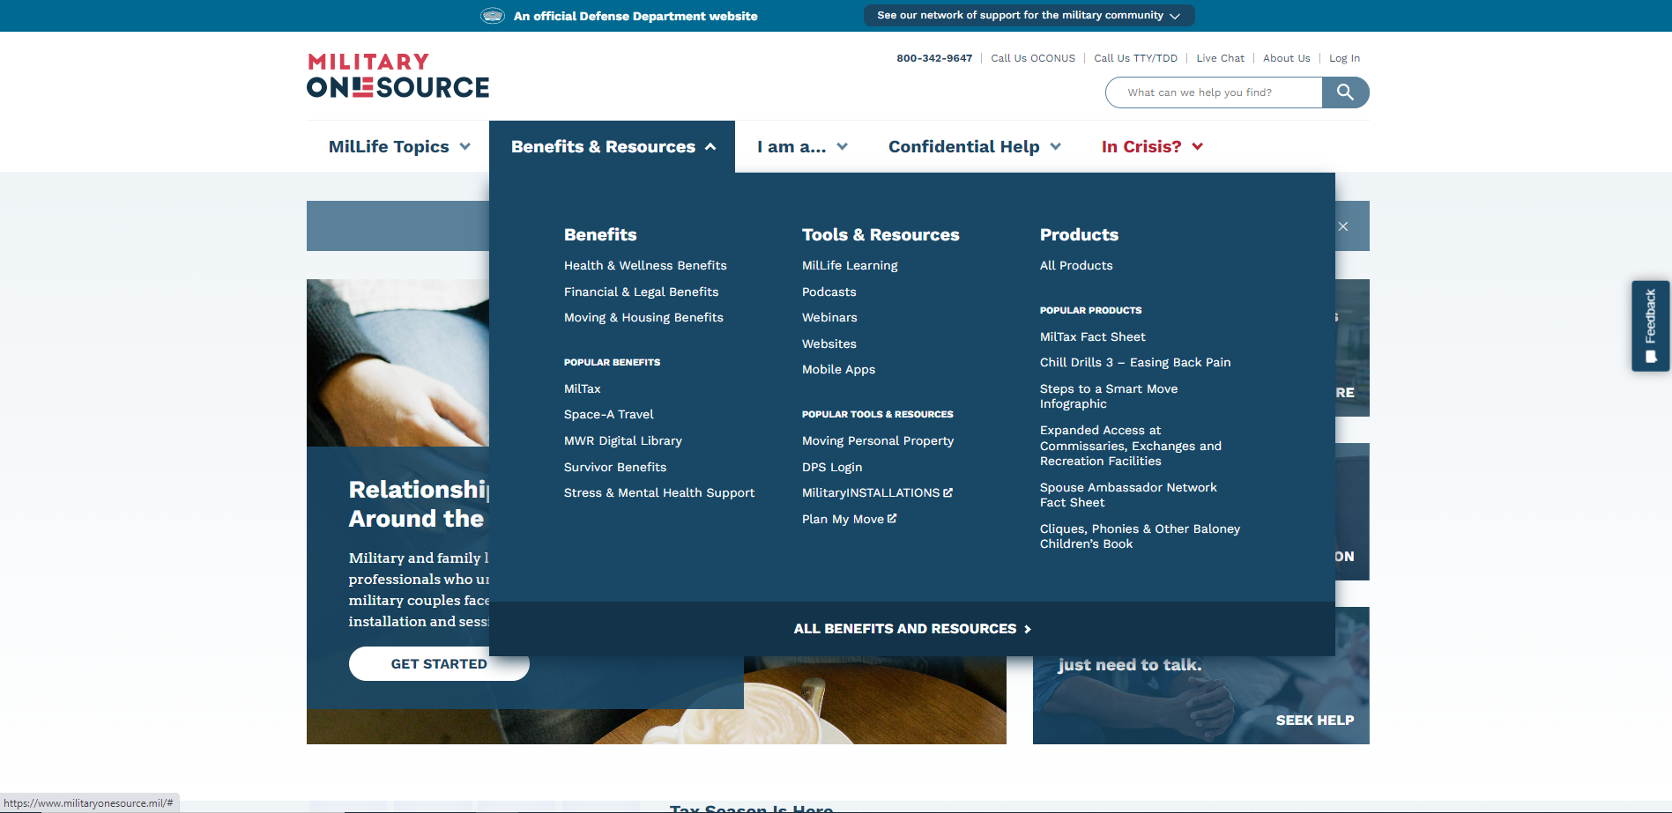
Military OneSource cont…
Notes:
FACILITATOR GUIDE:
When briefing this hit the major points of what is offered by Military OneSource. Example: popular benefits, what benefits are available, tools and resources, how to help with a PCS move. Recommend mentioning the stress and mental health support services available that can assist with acclimating with the challenges of military life.

Slide 12
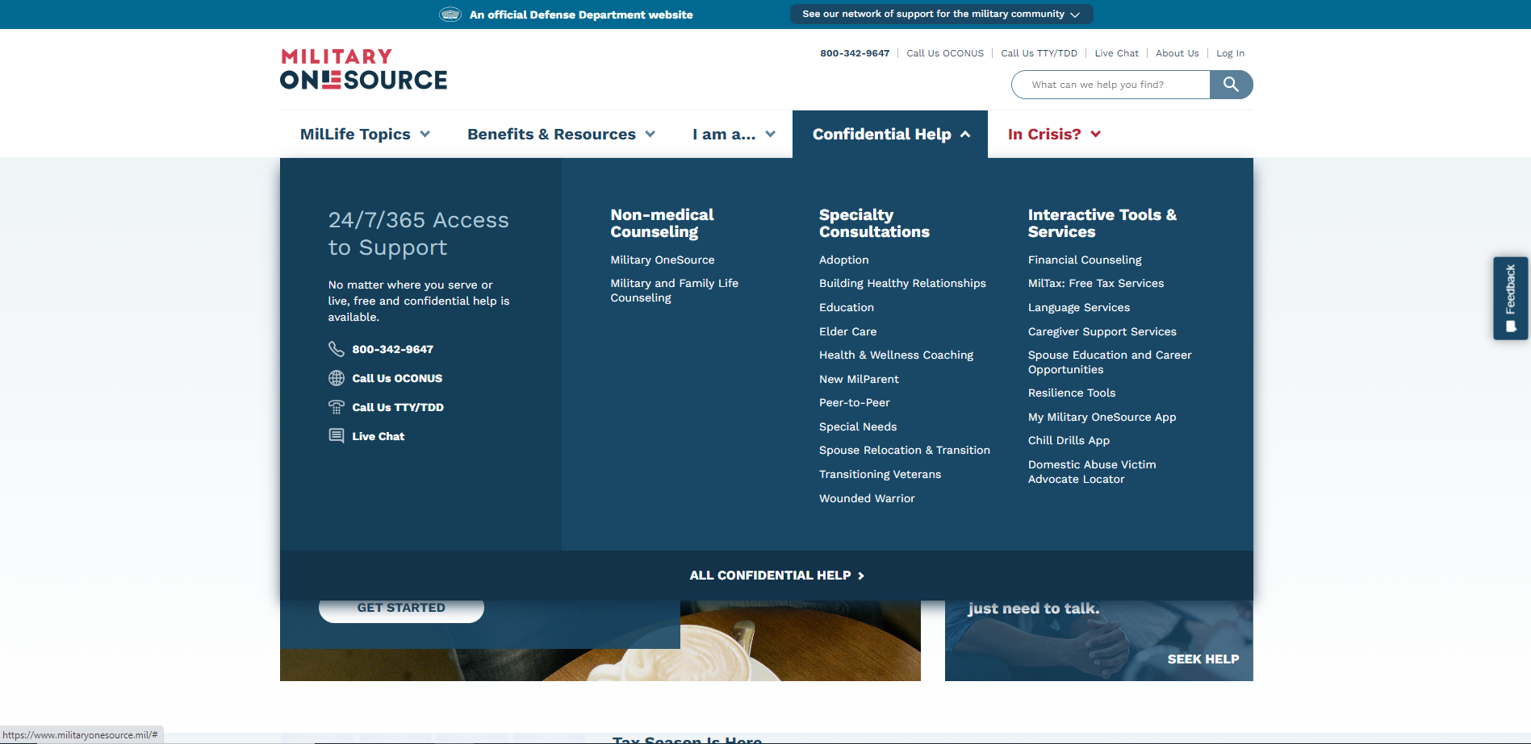
Military OneSource cont…
Notes:
FACILITATOR GUIDE:
When briefing this hit the major points of what is offered by Military OneSource. Mention how they are available 24/7 and services are free and confidential. Discuss how they can provide assistance with referring Sailors to Specialty consultations (see drop down for services available).

Slide 13
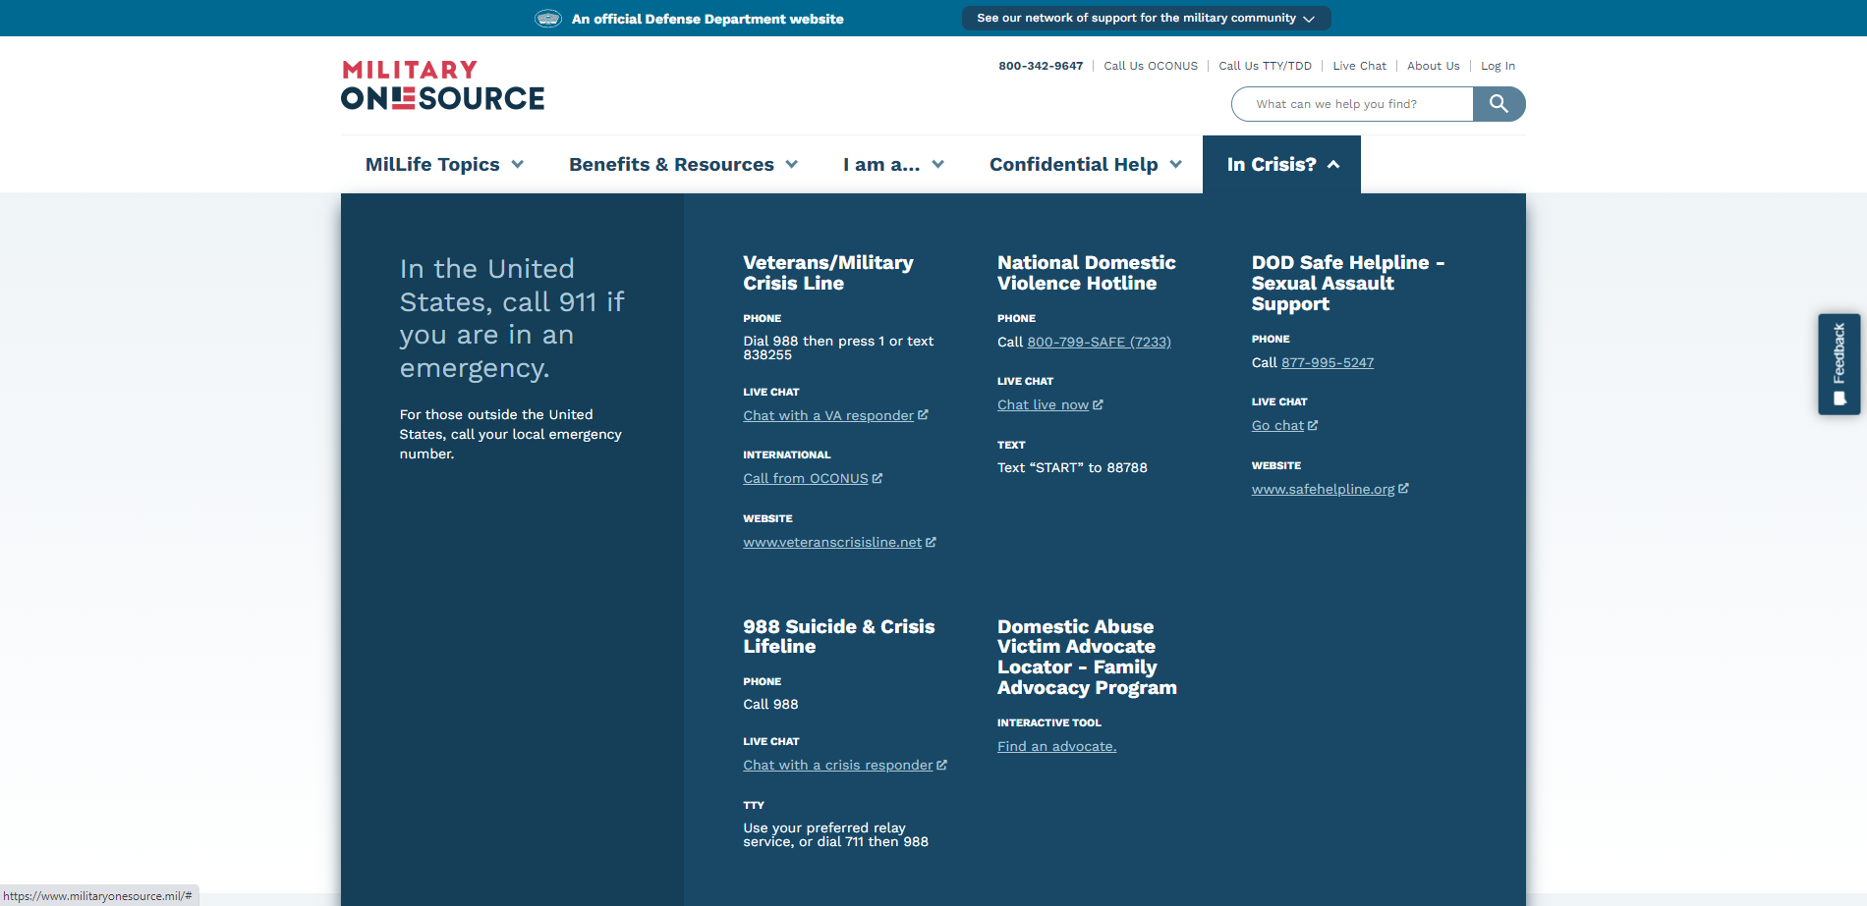
Military OneSource cont…
Notes:
FACILITATOR GUIDE:
When briefing this hit the major points of what is offered by Military OneSource. Mention how they are available 24/7 for crisis support such as suicide, domestic violence and sexual assault. Let Sailors know that no matter what they experience someone is available to talk to them even if they do not feel they can or are not comfortable talking to the Chain of Command. There’s always support available to them in times of need.

Slide 14
Navy-Marine Corps Relief Society
Navy-Marine Corps Relief Society provides several programs and services to assist active duty and retired Sailors, Marines and their families in financial need.
The mission of Navy-Marine Corps Relief Society is to provide, in partnership with the Navy and Marine Corps, financial, educational, and other assistance to members of the Naval Services of the United States, eligible family members, and survivors when in need; and to receive and manage funds to administer these programs.
Notes:
FACILITATOR GUIDE:
If possible provide current data regarding the assistance NMCRS has provided to Sailors in the fleet or your own command. Mention how NMCRS receives donations from Sailors and how these funds are used to help Sailors in times of need. If you have an NMCRS representative at the command take this time to mention who they are and provide contact information if available.

Slide 15
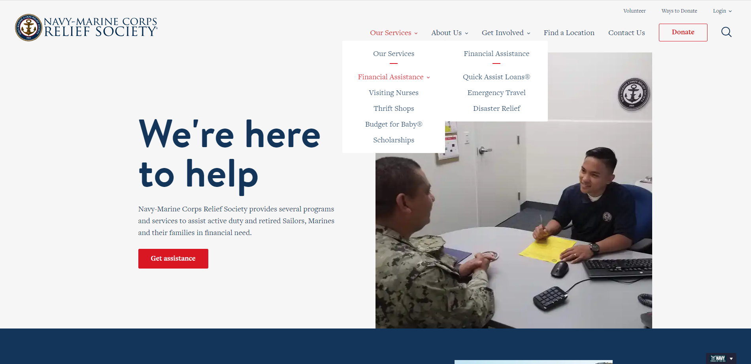
Navy-Marine Corps Relief Society cont…
Notes:
FACILITATOR GUIDE:
Use this slide to show Sailors what is available when they go to the NMCRS website. Take this times to mention the services NMCRS has for service members and their families such as: financial counseling, quick loans, etc.

Slide 16
Review and Summary
OMBUDSMAN
Military Fleet and Family Support Centers
Military OneSource
Navy-Marine Corps Relief Society
Questions?
Notes:
FACILITATOR GUIDE:
Provide a review and summary of covered topics. Below are questions to ask the class:
What is the role of an Ombudsman within a command?
What are some areas that Fleet and Family Support cover?
What type of resources are available on Military OneSource website?
What are some services that the Navy Marine Corps Relief Society provide?

